Slide 1
COMPUTER NETWORK
NAME:
珍古絲汀
4110E238
TEACHER: MYDEARGREATTEACHER

Slide 2
AGENDA
Computer network
Wan.man.lan.pan
Hardware
network connecting device
Network topology
Software
OSI MODEL
TCP/IP protocol
Window network command

Slide 3
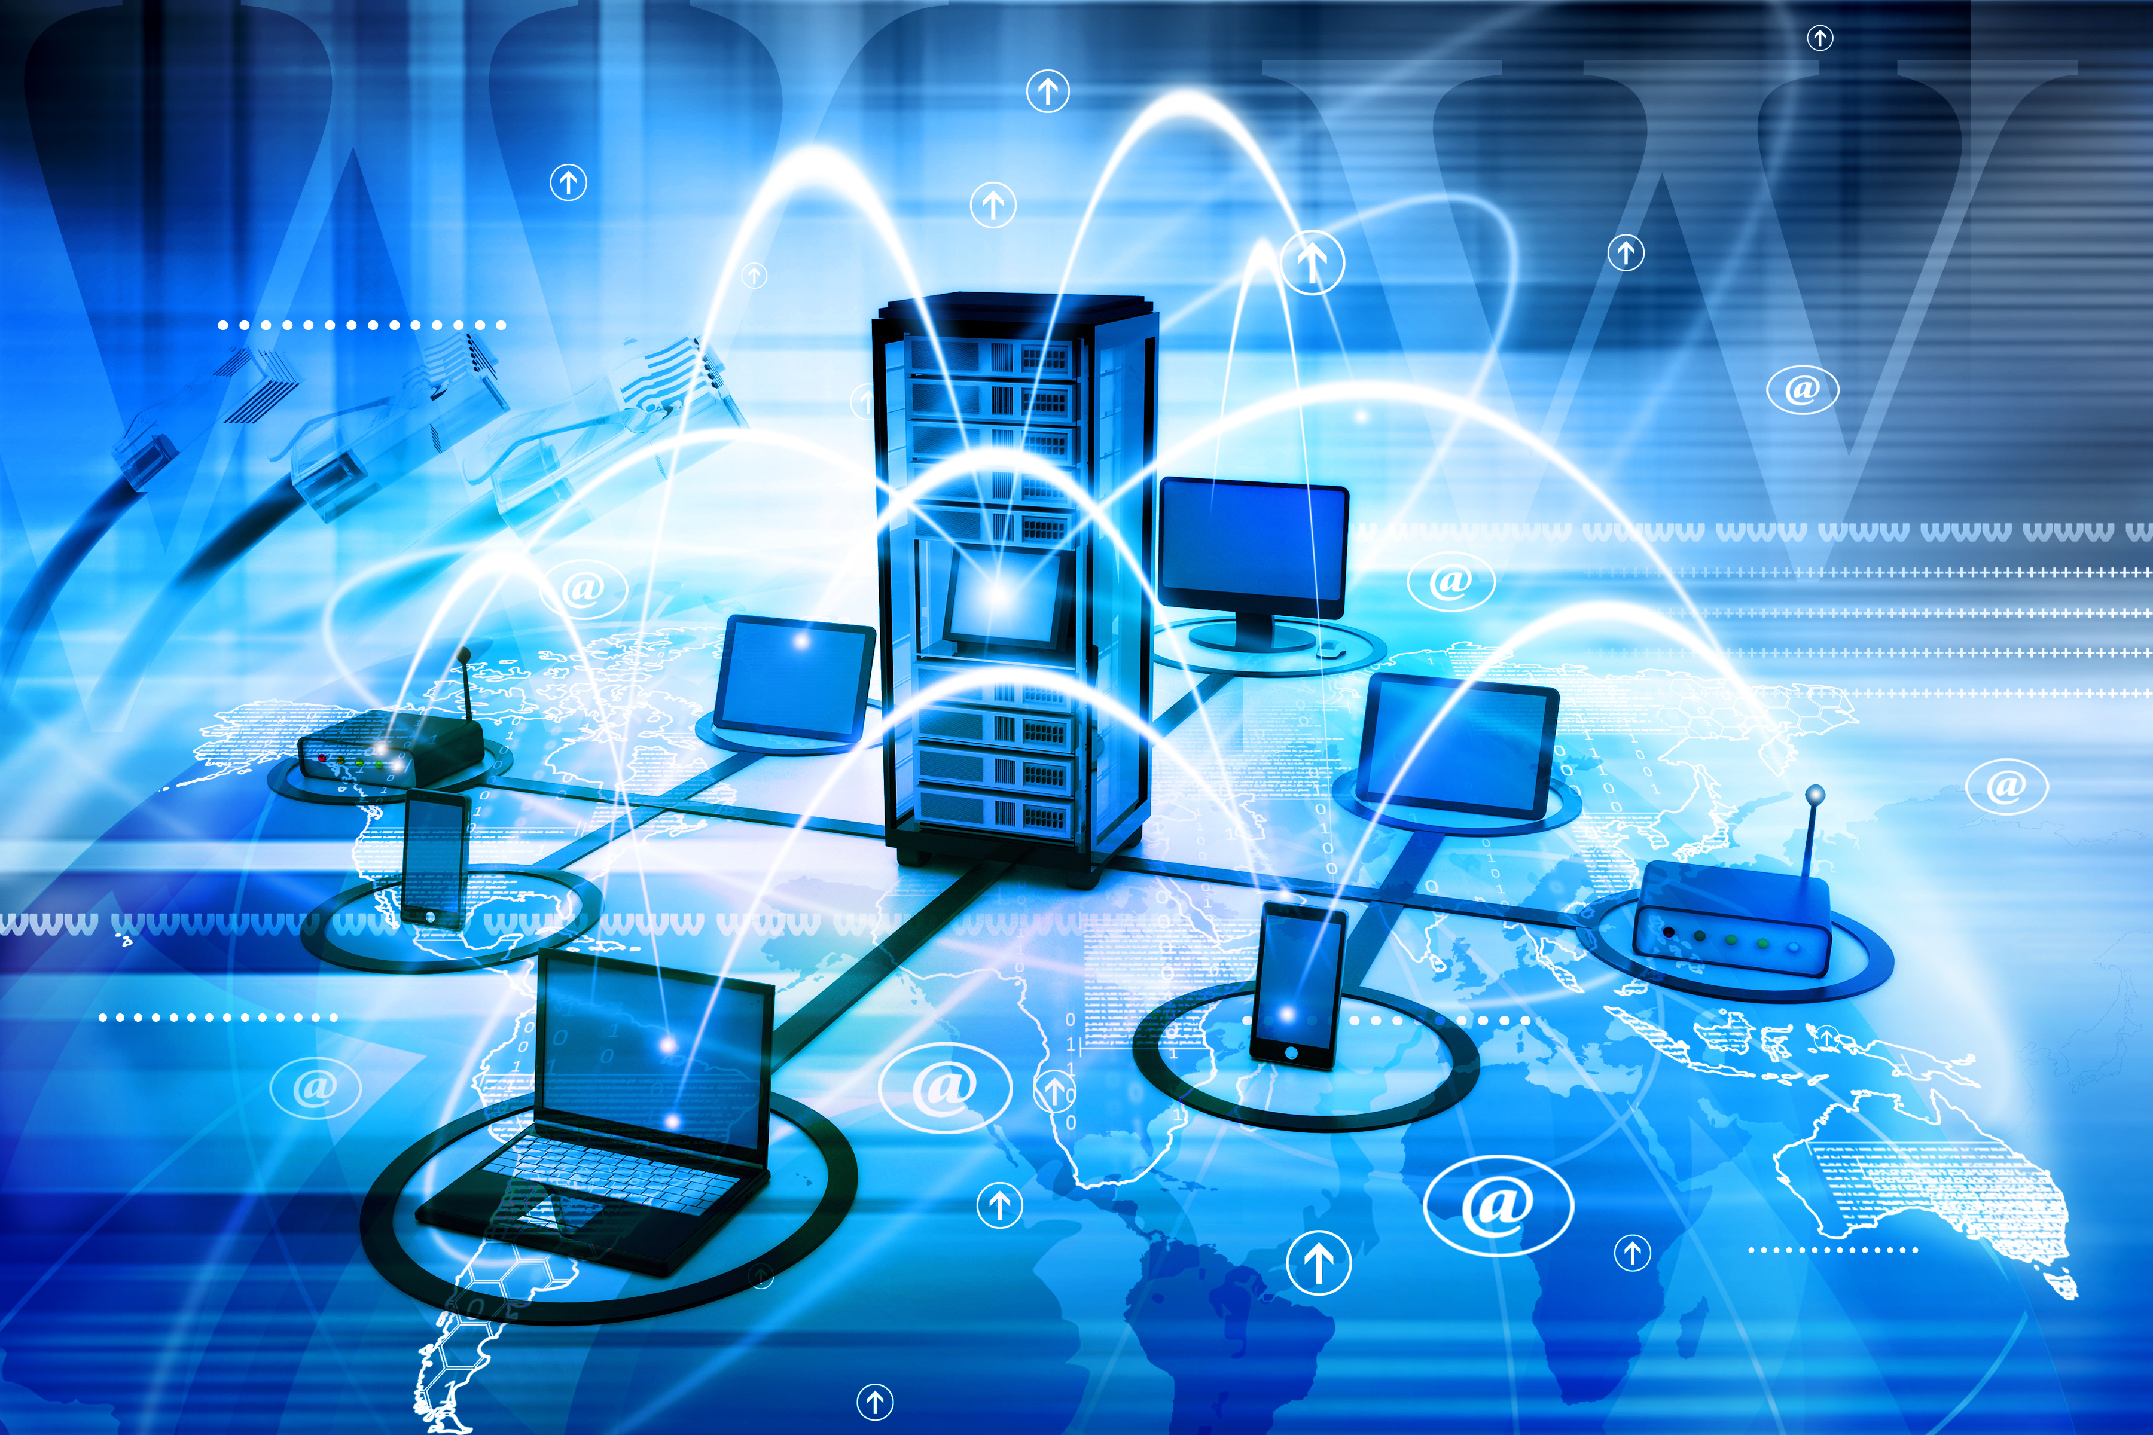
COMPUTER NETWORK
Computer networking
refers to interconnected computing devices that can exchange data and share resources with each other. These networked devices use a system of rules, called communications protocols, to transmit information over physical or wireless technologies.

Slide 4
HARDWARE: NERTWORK CONNECTING DEVICE
L1 devices: repeater hub
L2 devices: bridge switch
L3 devices: router L3 – switch;L3 ASIC + L2 switch
L4 devices:
L7 devices:

Slide 5
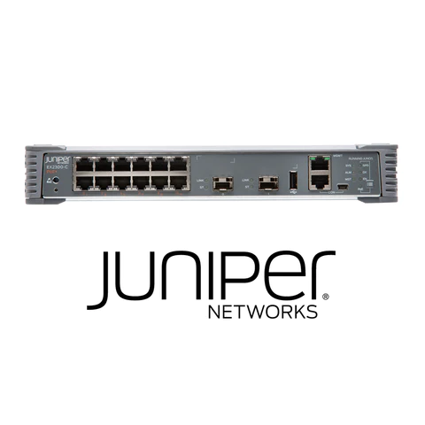
SWITCH VLAN

Slide 6
SWITCH VLAN
A group of end stations and the switch ports that link them together make up a VLAN. The logical split may be justified for a variety of reasons, such as departmental or project membership. The end station and the port to which it is connected must both be members of the same VLAN in order for it to function physically.

Slide 7
VLAN VIRTUAL LOCAL AREA NETWORK
Any broadcast domain that is divided and isolated in a computer network at the data connection layer is known as a virtual local area network (VLAN) (OSI layer 2). [2] [3] A physical object that has been replicated and changed by additional logic within a local area network is referred to in this context as virtual. In order to create the look and functioning of network traffic that is physically on a single network but behaves as though it is split between several networks, VLANs work by attaching tags to network frames and processing these tags in networking systems. Despite being connected to the same physical network, VLANs can maintain network application separation without the deployment of additional sets of cabling and networking hardware.

Slide 8
NETWORK TOPOLOGY
The configuration of a communication network's components—links, nodes, etc.—is known as its topology. Network topology is a term used to define or explain the configuration of many forms of telecommunication networks, such as computer networks, industrial fieldbuses, and command and control radio networks.
The topological structure of a network is known as network topology, and it can be represented physically or conceptually. It is a graph theory application[3] where connecting devices are modeled as links or lines between the nodes, and communicating devices are modeled as nodes. Physical topology refers to where different network elements are located (such as device placement and cable installation), whereas logical topology shows how data moves throughout a network. Even if two networks may have different node distances, physical connections, transmission speeds, or signal kinds, their logical topologies might be the same. The physical layer of the OSI model is particularly interested in the physical topology of a network.

Slide 9
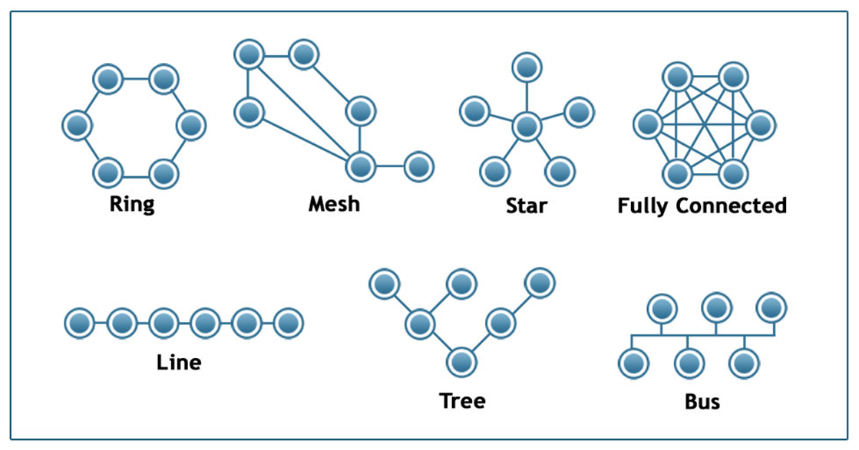

Slide 10
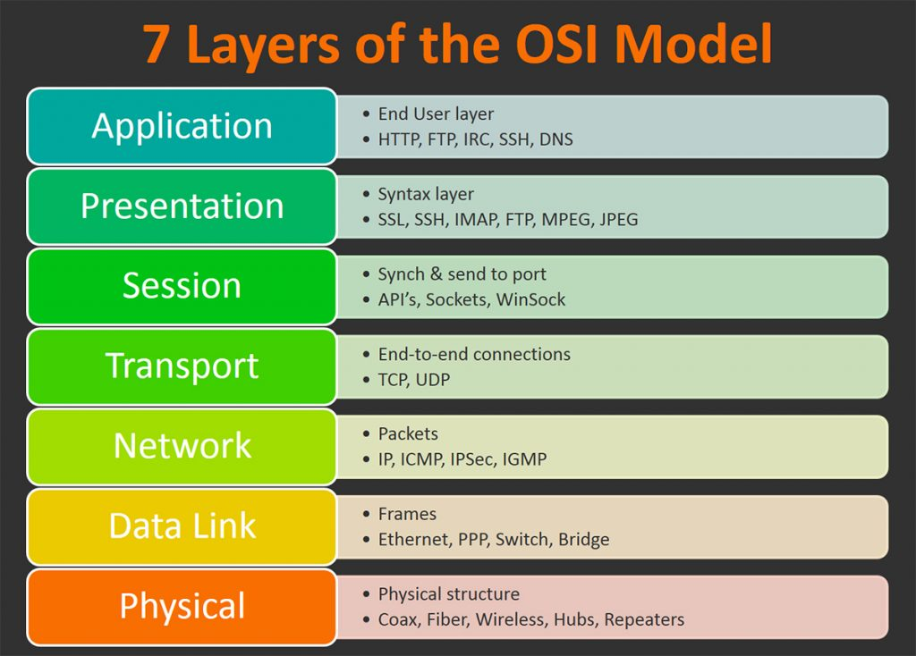
OSI MODEL
The seven levels that computer systems employ to interact over a network are described by the Open Systems Interconnection (OSI) model. In the early 1980s, all significant computer and telecommunications businesses adopted it as the first universal architecture for network communications.

Slide 11
OSI MODEL layer function
Layer 7: Application
End-user applications like web browsers and email clients operate at the application layer. It offers protocols that let computer programs transmit and receive data and give consumers useful information. The Hypertext Transfer Protocol (HTTP), File Transfer Protocol (FTP), Post Office Protocol (POP), Simple Mail Transfer Protocol (SMTP), and Domain Name System are a few examples of application layer protocols (DNS).

Slide 12
OSI MODEL layer function
Layer 6: Presentation
Data is prepared for the application layer by the presentation layer. In order for data to be correctly received on the other end, it specifies how two devices should encode, encrypt, and compress data. Any data transmitted by the application layer is processed by the presentation layer before being delivered via the session layer.

Slide 13
OSI MODEL layer function
Layer 5: Session
The session layer establishes sessions, or channels of communication, between devices. It is in charge of starting sessions, making sure they are active and open while data is being exchanged, and shutting them down once communication is complete. The session layer can also establish checkpoints during a data transmission, allowing devices to pick up where they left off in the event that the session is terminated

Slide 14
OSI MODEL layer function
Layer 4: Transport
Data transferred in the session layer is divided into "segments" by the transport layer at the receiving end. On the receiving end, it is in charge of putting the segments back together in order to create data that the session layer may use. The transport layer performs error control, which determines whether data was received wrongly and, if not, requests it again, as well as flow control, which sends data at a pace that matches the connection speed of the receiving device.

Slide 15
OSI MODEL layer function
Layer 3: Network
The network layer serves two primary purposes. One is dividing segments into network packets, which are then put back together at the other end. The alternative method of packet routing involves finding the optimum route through a physical network. In order to route packets to a destination node, the network layer needs network addresses, which are commonly Internet Protocol addresses.

Slide 16
OSI MODEL layer function
Layer 2: Data Link
The data link layer creates and breaks connections between two network nodes that are physically close to one another. Frames are created from packets, which are then sent from source to destination. This layer is made up of two components: Media Access Control (MAC), which utilizes MAC addresses to connect devices and specifies permissions to transmit and receive data, and Logic Link Control (LLC), which identifies network protocols, does error checking, and synchronizes frames.

Slide 17
OSI MODEL layer function
Layer 1: Physical
The physical layer is in charge of the wired or wireless connections that physically connect network nodes. In addition to defining the connector, the electrical cable or wireless technology connecting the devices, it is in charge of bit rate regulation and the transmission of raw data, which is just a stream of 0s and 1s.

Slide 18
Mesh ‘LAN’ local area network
A local area network (LAN) is a network made up of a number of computers that are connected in a certain area. TCP/IP ethernet or Wi-Fi is used in a LAN to link the computers to one another. A LAN is typically only accessible within a single establishment, such as a school, workplace, group, or church.

Slide 19
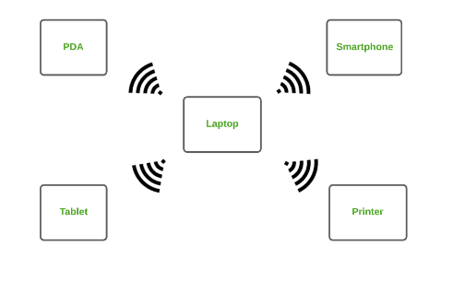
Types of Computer Networks
Personal Area Network (PAN) :
The most fundamental kind of computer network is a PAN. This network is limited to a single user, so that computing device communication is focused solely on the user's workspace. PAN gives a network range of 10 meters between a user's location and the communication equipment.

Slide 20
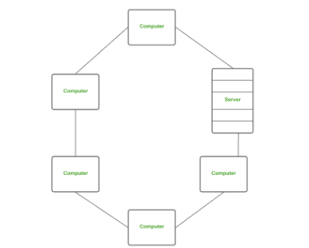
Local Area Network (LAN)
The most used type of network is LAN. A local area network, or LAN, is a type of computer network that links computers together through a common communication connection. Two or more computers connected via a server make up a LAN. Ethernet and Wi-fi are the two key technologies used in this network.

Slide 21
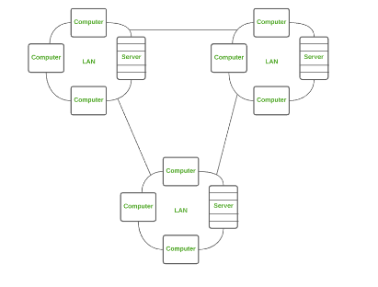
Wide Area Network (WAN)
A WAN is a kind of computer network that utilizes a common communication path to connect computers separated by a great distance. It spans numerous locations rather than being limited to just one. A collection of local area networks that communicate with one another can also be referred to as WAN.

Slide 22
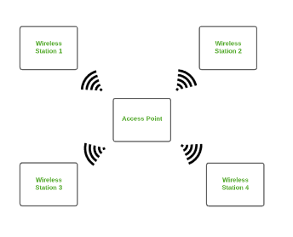
Wireless Local Area Network (WLAN)
A WLAN uses wireless network technology, such as Wi-Fi, yet functions as a local area network. Instead of using physical cables like in a LAN, this network enables wireless communication between devices.

Slide 23
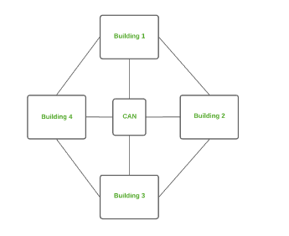
Campus Area Network (CAN)
While being smaller than a MAN, CAN is larger than a LAN. This particular kind of computer network is frequently utilized in establishments like schools and colleges. This network is dispersed over multiple buildings on the campus, so it only covers a small area of land.

Slide 24
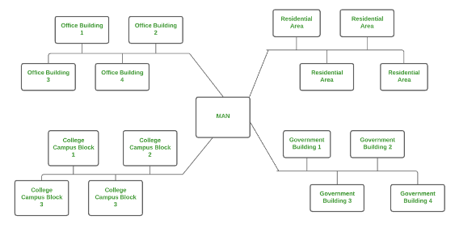
Metropolitan Area Network (MAN)
While being smaller than a WAN, a MAN is larger than a LAN. This kind of computer network utilizes a shared communication path across a city, town, or metropolitan area to link computers that are separated by distance.

Slide 25
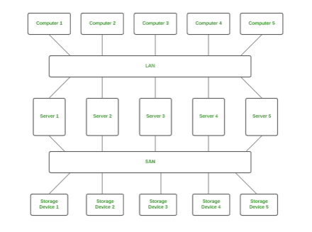
Storage Area Network (SAN)
A high-speed computer network called SAN links collections of storage devices to numerous servers. LAN and WAN are not necessary for this network. The storage resources are instead transferred from the network to its own powerful network by a SAN. A SAN gives access to block-level data storage.

Slide 26
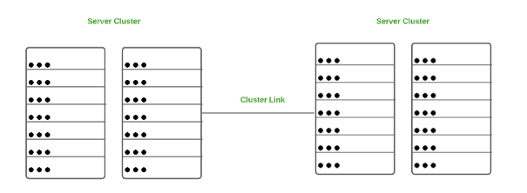
System Area Network (SAN)
A SAN is a specific kind of computer network that links a collection of powerful machines. It is a high bandwidth, connection-oriented network. A SAN is a kind of LAN that can handle huge requests for big volumes of information. Applications processing on this network benefit from its excellent network performance.

Slide 27
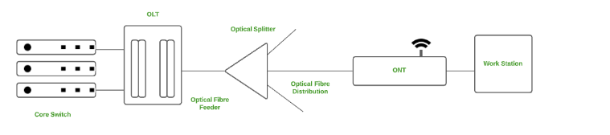
Passive Optical Local Area Network (POLAN)
An alternative to a LAN in terms of computer networks is a POLAN. In order to disperse users and devices, POLAN uses optical splitters to divide an optical signal from a single strand of single mode optical fiber into several streams. POLAN is a point-to-multipoint LAN architecture, to put it briefly.

Slide 28
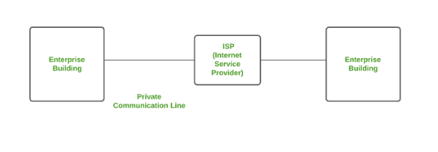
Enterprise Private Network (EPN)
Businesses that need a secure connection across multiple sites to share computer resources frequently use the EPN kind of computer network.

Slide 29
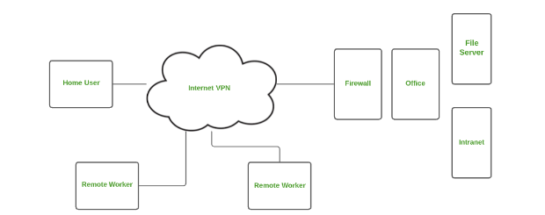
Virtual Private Network (VPN)
A VPN is a kind of computer network that enables users to send and receive data as if they were connected to a private network even if they are not by extending a private network across the internet. An online virtual point-to-point connection enables users to remotely access a private network. By acting as a conduit for a secure network connection, a VPN shields you from harmful sources.

Slide 30
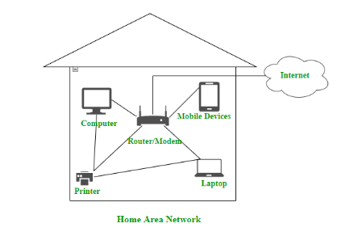
Home Area Network (HAN)
There may be more than one computer in many of the homes. A network should be constructed comparable to the local area network (LAN) in that home to connect those PCs and with other peripheral devices. The term "home area network" refers to a particular kind of network that enables a user to link numerous PCs and other digital devices inside the home (HAN). The HAN promotes network-wide resource, file, and program sharing. Both cable and wireless communication are supported.

Slide 31
COMPUTER NETWORK:SOFT WARE

Slide 32
TCP/ICP PROTOCOL SUITE
TCP/IP suite of protocols
The TCP/IP suite is a set of protocols used on computer networks today (most notably on the Internet). It provides an end-to-end connectivity by specifying how data should be packetized, addressed, transmitted, routed and received on a TCP/IP network. This functionality is organized into four abstraction layers and each protocol in the suite resides in a particular layer.

Slide 33
The TCP/IP suite is named after its most important protocols, the Transmission Control Protocol (TCP) and the Internet Protocol (IP). Some of the protocols included in the TCP/IP suite are:
ARP (Address Resolution Protocol) – used to associate an IP address with a MAC address.
IP (Internet Protocol) – used to deliver packets from the source host to the destination host based on the IP addresses.
ICMP (Internet Control Message Protocol) – used to detects and reports network error conditions. Used in ping.
TCP (Transmission Control Protocol) – a connection-oriented protocol that enables reliable data transfer between two computers.

Slide 34
UDP (User Datagram Protocol) – a connectionless protocol for data transfer. Since a session is not created before the data transfer, there is no guarantee of data delivery.
FTP (File Transfer Protocol) – used for file transfers from one host to another.
Telnet (Telecommunications Network) – used to connect and issue commands on a remote computer.
DNS (Domain Name System) – used for host names to the IP address resolution.
HTTP (Hypertext Transfer Protocol) – used to transfer files (text, graphic images, sound, video, and other multimedia files) on the World Wide Web.

Slide 35
HTTPS
An addition to the Hypertext Transfer Protocol is called Hypertext Transfer Protocol Secure (HTTPS) (HTTP). It is frequently used on the Internet and employs cryptography for secure communication over computer networks. HTTPS encrypts communication using Transport Layer Security (TLS), formerly known as Secure Sockets Layer (SSL). As a result, the protocol is sometimes known as HTTP over SSL or HTTP over TLS.

Slide 36
COMPUTER NETWORK

Slide 37
COMPUTER NETWORK: WINDOW COMMAND
A command line interpreter tool called Windows Command Prompt is available with every version of Windows OS, starting with Windows NT. It resembles the Disk Operating System (DOS), a console-based operating system that was popular before Windows became a graphical user interface.

Slide 38
What are internal computer hardware components?
Internal components collectively process or store the instructions delivered by the program or operating system (OS)
include the following:
Motherboard. This is a printed circuit board that holds the central processing unit (CPU) and other essential internal hardware and functions as the central hub that all other hardware components run through.
CPU. The CPU is the brain of the computer that processes and executes digital instructions from various programs; its clock speed determines the computer's performance and efficiency in processing data.
RAM -- or dynamic RAM -- is temporary memory storage that makes information immediately accessible to programs; RAM is volatile memory, so stored data is cleared when the computer powers off.

Slide 39
Hard drive. Hard disk drives are physical storage devices that store both permanent and temporary data in different formats, including programs, OSes, device files, photos, etc.
Solid-state drive (SSD). SSDs are solid-state storage devices based on NAND flash memory technology; SSDs are non-volatile, so they can safely store data even when the computer is powered down.
Optical drive. Optical drives typically reside in an on-device drive bay; they enable the computer to read and interact with nonmagnetic external media, such as compact disc read-only memory or digital video discs.

Slide 40
Heat sink. This is a passive piece of hardware that draws heat away from components to regulate/reduce their temperature to help ensure they continue to function properly. Typically, a heat sink is installed directly atop the CPU, which produces the most heat among internal components.
Graphics processing unit. This chip-based device processes graphical data and often functions as an extension to the main CPU.
Network interface card (NIC). A NIC is a circuit board or chip that enables the computer to connect to a network; also known as a network adapter or local area network adapter, it typically supports connection to an Ethernet network

